Slide 1
android Development practice
android app 开发之 Adapter
Michael xu
2016-09-08

Slide 2
Agenda
Environment
Android System Architecture
Android App Project Structure
Android 新特性如何兼容老版本？
Android Components -- Adapter
Q & A

Slide 3
Environment Tools
Android SDK
JDK
Android Studio
Eclipse

Slide 4
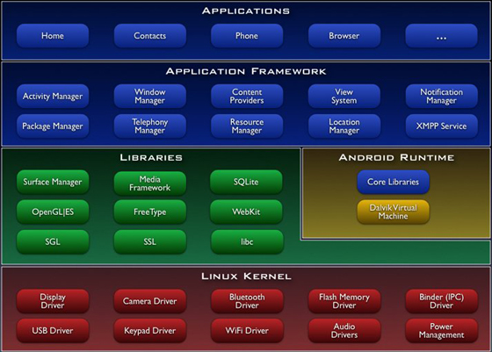
Android System Architecture

Slide 5
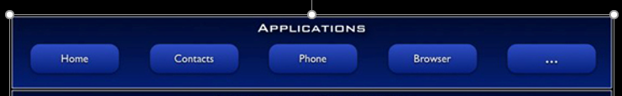
App 开发的范围

Slide 6
Android UI Component(1)
View
TextView
EditView
Button
RadioButon
CheckBox
ToggleButton
Switch

Slide 7
Android UI Component(2)
AnalogClock
TextClock
ImageView
ImageButton
ZoomButton
QuickContactBradge
ProgressBar
SeekBar
RatingBar

Slide 8
Android UI Component(3)
ListView
GridView
ExpandableListView
Spinner
Gallery
AutoCompleteTextView
AdapterViewFlipper
StackView

Slide 9
Android UI Component(4)
ViewSwitch
ImageSwitch
TextSwitch
ViewFlipper
Toast
CalendarView
DatePicker
TimPicker
NumberPicker

Slide 10
Android UI Component(5)
SearchView
TabHost
ScrollView
Notifiction
AlertDialog
PopupWindow
ActionBar
Fragment

Slide 11
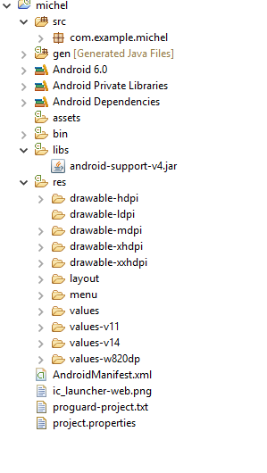
Eclipse 项目组织结构

Slide 12
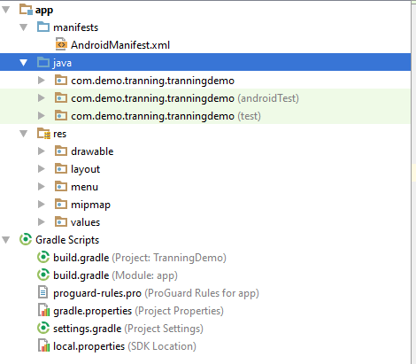
Android Studio 文件组织结构

Slide 13
Android 向前兼容插件
Android Support V4 --1.6+
Android Support V7 --2.1+
Android Support V13 --3.2+

Slide 14
Material Design 兼容包
Android Design Support Library
兼容到android 2.2
官方英文文档： https://material.google.com/
中文版网站： http://wiki.jikexueyuan.com/project/material-design/
中文版 GitHub 仓库： https://github.com/1sters/material_design_zh_2

Slide 15
Material Design设计素材
Material Design Icons
https://github.com/google/material-design-icons
Awesome Android UI
https://github.com/wasabeef/awesome-android-ui

Slide 16
复杂组件*Adapter
ListView
GridView
ExpandableListView
Spinner
AutoCompleteTextView
AdapterViewFlipper
StackView

Slide 17
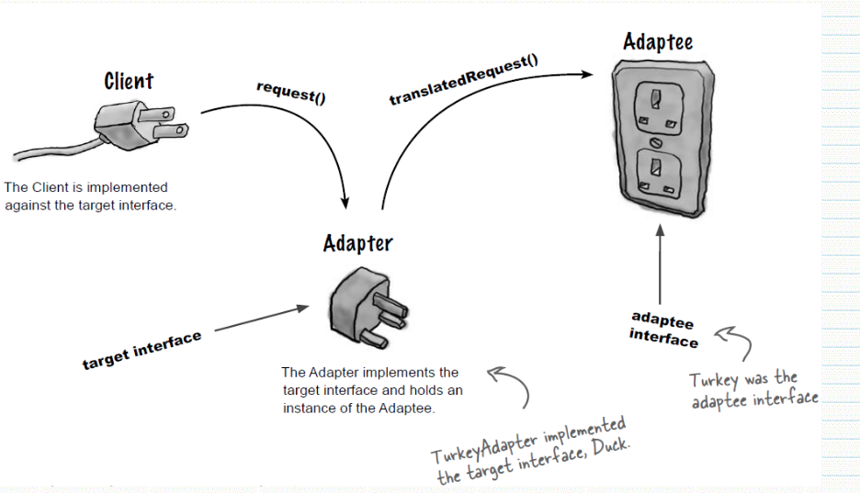
Adapter

Slide 18
Android Adapter 组件
Android 提供了各种各样的适配器
BaseAdapter

Slide 19
Demo

Slide 20
Reference resource
http://developer.google.com

Slide 21
Q & A

